Slide 1
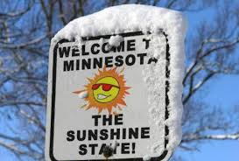

Slide 2
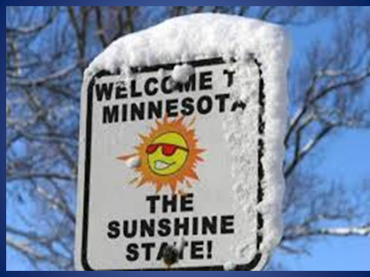
?
Do you support or oppose a Single Payer health care system where all Americans would get their health insurance from the government? Do you….?
Strongly Support
Somewhat Support
Somewhat Oppose
Strongly Oppose
Don’t Know

Slide 3
?
Do you support or oppose a Single Payer health care system where all Americans would get their health insurance from the government? Do you….?
Strongly Support 27%
Somewhat Support 23%
Somewhat Oppose 13%
Strongly Oppose 20%
Don’t Know 17%
Morning Consult-Politico
National Tracking Poll
June 7-10, 2018
N=1994

Slide 4


Slide 5
QUESTIONS?
What do some Minnesotans:
  Know
  Feel
  Think
  Believe
  Hope & Fear
Single Payer & Health Care?
What cognitive connections do they already attach to the Single Payer
  Barriers
  Opportunities
How do they feel about insurance companies? How do they feel about government?
What does it mean when Minnesotans say they want health care fixed?
What does the term “Single Payer” mean to some Minnesotans? How do they define it? We talkask them to evaluate it in a poll?

Slide 6
WHY ASK?
While We Have a GREAT OPPORTUNITY…
  We are also confronted with GREAT CHALLENGES/BARRIERS
And it is HIGHLY PROBABLE that the messages and values
that have brought you all here today
  Will not (by themselves) carry the day when the SINGLE PAYER fight is fully engaged.
Fight Smarter!

Slide 7
Fight Smarter!

Slide 8
? Some MNs ?
Do you support or oppose a Single Payer health care system where all Americans would get their health insurance from the government? Do you….?
ALL Dem Ind Rep
Strongly Support 27% 42% 25% 14%
Somewhat Support 23% 30% 24% 13%
Somewhat Oppose 13% 7% 15% 17%
Strongly Oppose 20% 5% 17% 41%
Don’t Know 17% 16% 19% 16%

Slide 9
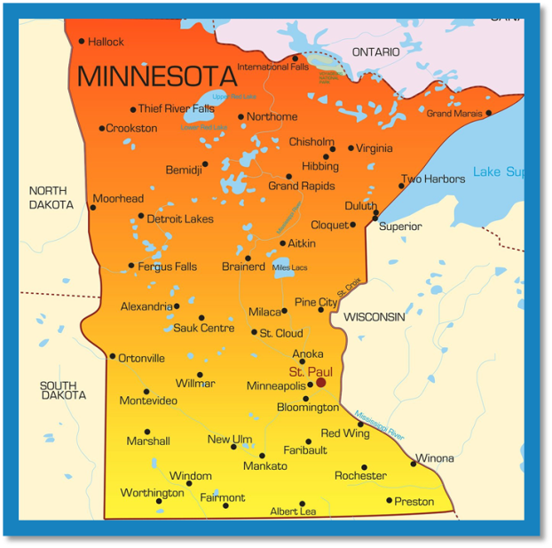
WHO ?
8 Focus Groups—Qualitative Research
Divided by Gender
25-70 years of Age
3 in Greater Minnesota & 1 in the Twin Cities
All Political Parties but Ideological Extremes Excluded
Full Array of Health Insurance
From Voter File – Not Focus Group Pros
Broad range of income and employment
SMALL PRINT: Qualitative, not quantitative. Findings not mirror of MN as a whole. Findings provide insights into how some Minnesotans think about Single Payer and can be used to refine messages, arguments, and how a policy is framed.

Slide 10
What We Learned?
Barriers & Opportunities Abound
For Example: Take Language
Is Health Care a…
…Right or a Privilege?

Slide 11
What We Learned?
Right or Privilege is a Polarized Debate the answer to Which REVEALS the MESSENGER’S PARTY PREFERENCE & in doing so may lessen his or her credibility!
You just might be a Democrat if you Say Right
You just might be a Republican if you Say Privilege
You are Talking Their Language (and avoiding a partisan messenger trap ) if you simply say:
  Health Care is Basic Need
Notes:
Barrier is when we fall into the Right-Privilege Trap
Opportunity is when we say Basic Need

Slide 12
?What ELSE 1
People think healthcare system is broken.*
& Insurance is:
  Too Complicated – 3Bs
    Bureaucracy, Billing, and Barriers to Care
  Random, Irrational, Unfair, and Indecipherable
  Rife with Greed & Replete Inexplicable Costs and Cost Increases
Insurance companies are untrustworthy, bottomline, middlemen.
Notes:
*Not quality – at least in Minnesota…it is the insurance that is broken – see page 8
Put in quotes page 9 and page 10
Barrier or Opportunity????Seems like an opportunity BUT

Slide 13

? What ELSE 2
People Don’t Trust Government
  To Make Changes that Solves these Problems
BECAUSE the government doesn’t work for them. It works for someone or something else.
TO THEM: it is GUBMENT VS. GEICO.
Neither one is on their side.
Notes:
Page 5

Slide 14
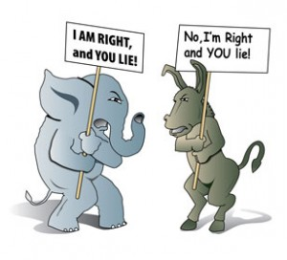
POLITICAL POLARIZATION
EXACERBATES
THIS!
Notes:
Page 6
So Gub’ment replacing insurance companies only a plus with people who like or believe in the importance of govt and that is mostly us…people already on our side

Slide 15
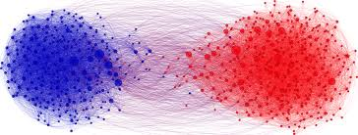
IS INCREASING
POLARIZATION
OUR ONLY
BARRIER TO SUCCESS?
Notes:
NO

Slide 16

8
MYTHS, TROPES, TALES,
STORIES, URBAN LEGENDS,
CONSPIRACY THEORIES, & FEARS
Notes:
Barriers Embedded in some psyches…Potholes you will find when going door-to-door
Page 12-1

Slide 17

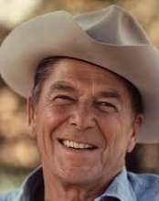
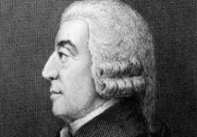
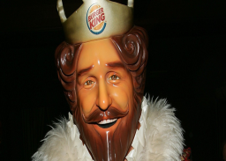
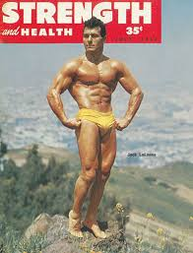

THE 8 MYTHS, TROPES, TALES, STORIES,
URBAN LEGENDS, CONSPRIRACIES, & FEARs
Government isn’t….
Competition will…
Have it Your Way…
I’m Invincible…
Greedy Trial Lawyers
Notes:
Barriers Embedded in some psyches…Potholes you will find when going door-to-door
Page 12-1

Slide 18

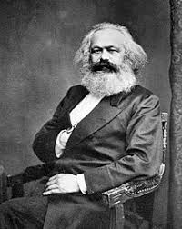

MORE TROPES, STORIES, TALES,
CONSPIRACY THEORIES & FEARMONGERING
Lazy People – the Others!
Socialized Medicine!
Apocryphal Health Care Nightmares
Barriers: Collective Consciousness
Notes:
Barriers Embedded in some psyches
Page 12-13
Page 16
Page 17 VA

Slide 19
OPPORTUNITIES?
1. People Know: System is Broken
2. Health Care is Front and Center as a Policy Concern That People Want to Be Fixed
3. Rising Costs, Falling Coverage, Bureaucracy, and Talk of Ending Pre-Existing Coverage Requirement Increasing Concern and Demand for Change
Our Solution Produces Real Benefits (though people may not believe them.
Notes:
Barriers Embedded in some psyches
Page 12-13
Page 16
Page 17 VA

Slide 20
OPPORTUNITIES?
Sell the Benefits.
  Not the Rhetoric,
  Not the Ideology,
  Not Your Fervor and Passion for It,
  Not the Politics of it
  Not the Correctness of the Idea
Sell the Practical Benefits of It To People
That’s the Way to Win
Notes:
Barriers Embedded in some psyches
Page 12-13
Page 16
Page 17 VA

Slide 21
What Are Those Benefits?
Provides Access to Care for All in a fair, responsible and equitable way
  Access for a Basic Need – Health Care
Simple and Streamlined System
Cost Savings
Quality Remains
Adds Dental and Vision Care
No more in/out of network
No worry about pre-existing conditions
Notes:
Barriers Embedded in some psyches
Page 12-13
Page 16
Page 17 VA

Slide 22
INDICATIVE of Message Disconnects, Barriers, and Challenges Single Payer Confronts In Minnesota and, to a certain extent, the U.S.
Not REPRESENTATIVE!
Use them a Cautionary GUIDE
that is Much Better than your GUT
Notes:
Page 15

Slide 23
What is in a Name?
A LOT
Single Payer MFA
Strongly Support 27% 37%
Somewhat Support 23% 26%
Somewhat Oppose 13% 11%
Strongly Oppose 20% 15%
Don’t Know 17% 11%
I
Notes:
Page 15

Slide 24
What is in a Name?
What we call our solution(s) needs to be simple and descriptive AND unencumbered (as much as possible) by negative baggage.
At the national level Medicare For All appears to be more meaningful than Single Payer.
In Minnesota, at least in our groups, the name Minnesotans devised themselves for what was a single payer plan was simply the Minnesota Health Plan – a simple and local name
Notes:
Page 15

Slide 25
Great Opportunity to Win the Struggle for Healthcare for All
There are also significant Challenges and Barriers standing in our way.
Identifying the Opportunities as well as Challenges and Barriers confronting us was the goal of the MNA Research.
Because By Fighting Smarter, We Can Win

